Slide 1

Big Data Visual Analytics (CS 661)
Instructor: Soumya Dutta
Department of Computer Science and Engineering
Indian Institute of Technology Kanpur (IITK)
email: soumyad@cse.iitk.ac.in

Slide 2
Study Materials for Lecture 6
The Visualization Toolkit by Will Schroeder, Ken Martin, Bill Lorensen
Chapter 7 (Volume Rendering section)
GPU Gems Volume Rendering:
https://developer.nvidia.com/gpugems/gpugems/part-vi-beyond-triangles/chapter-39-volume-rendering-techniques
For detailed mathematical modeling and algorithm
Optical Models for Direct Volume Rendering by Nelson Max

Slide 3
Acknowledgements
Some of the following slides are adapted from the excellent course materials and tutorials made available by:
Prof. Han-Wei Shen (The Ohio State University)
Prof. Klaus Mueller (State University of New York at Stony Brook)
Engel, Hadwiger, Salama; Real time volume graphics tutorial, EuroGraphics 2006

Slide 4
Volume Rendering Demo in ParaView

Slide 5
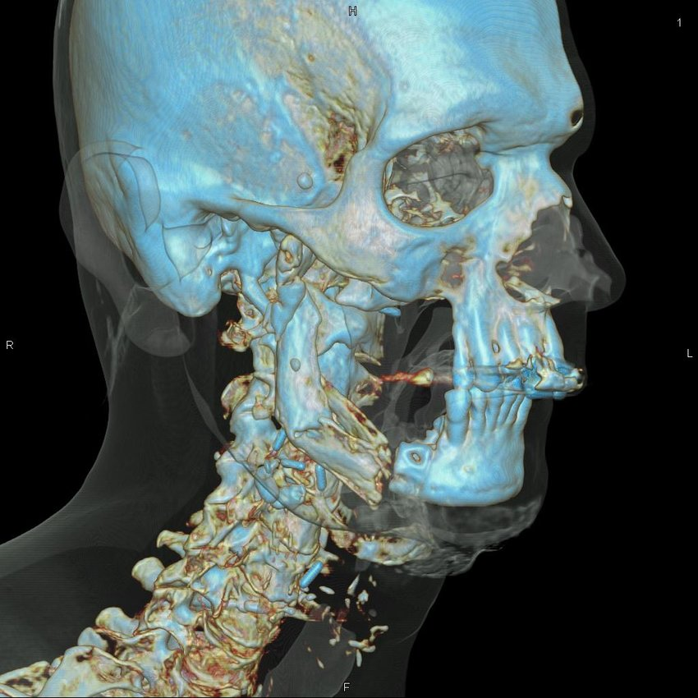
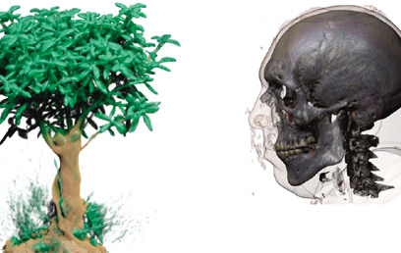
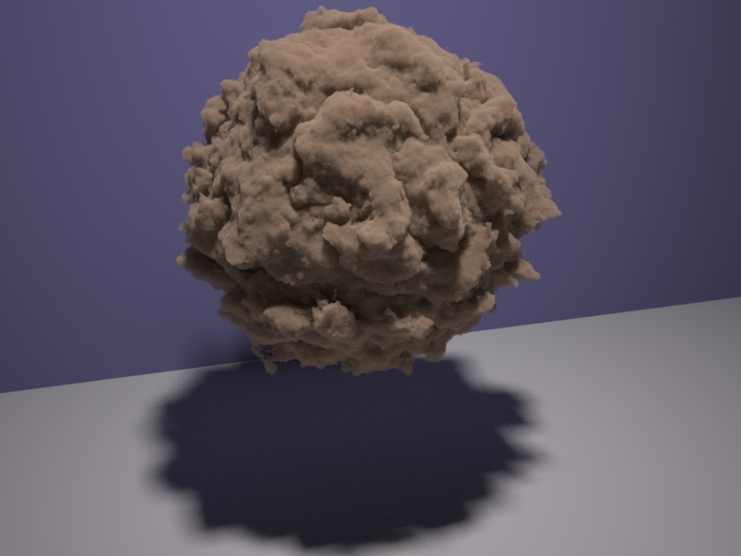
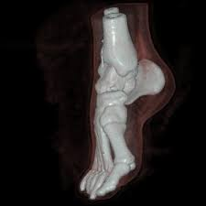
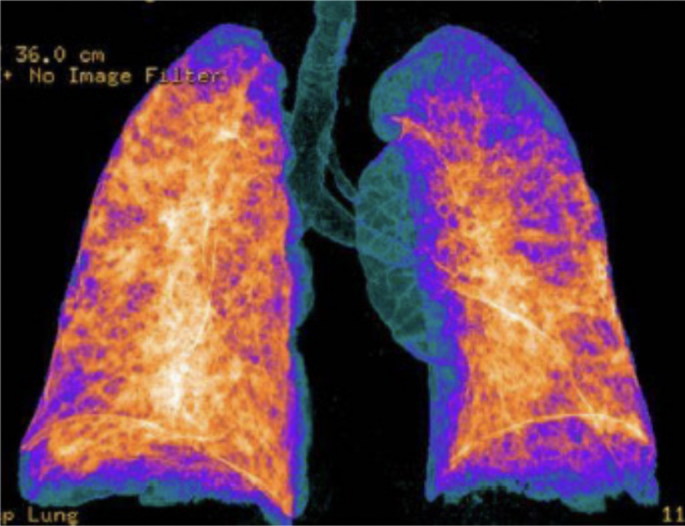
Volume Rendering

Slide 6
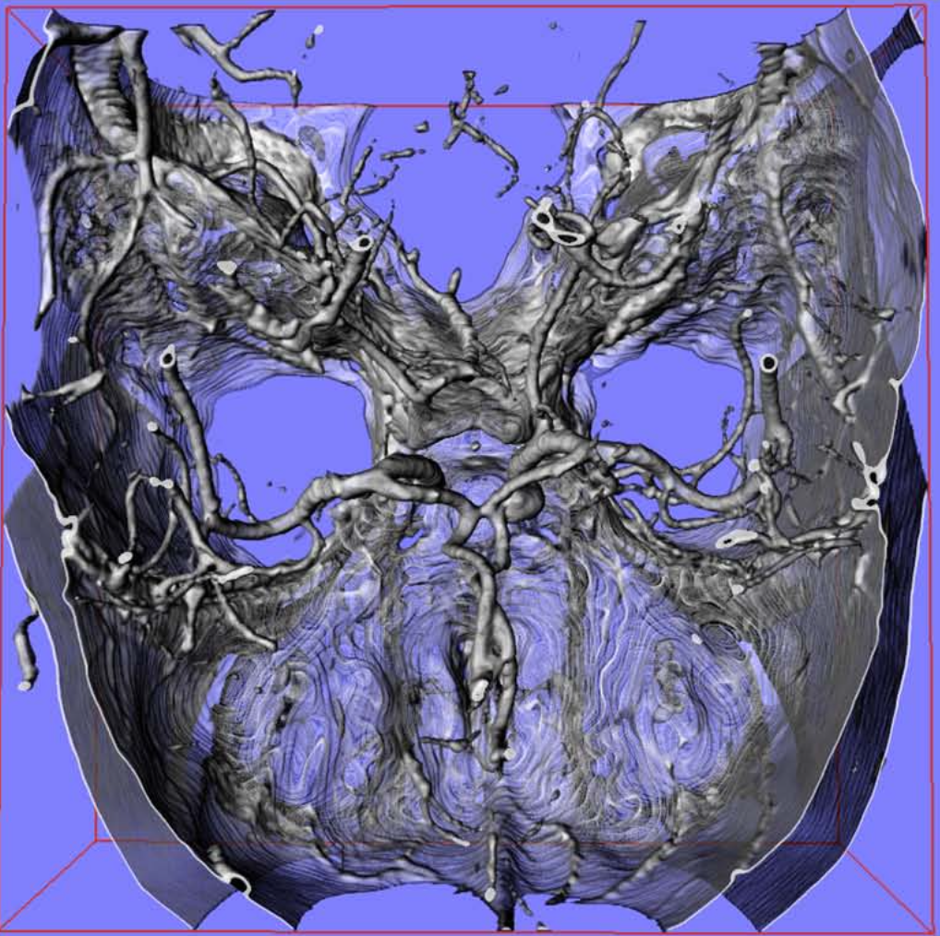
Applications: Medical Science
CT Angiography

Slide 7
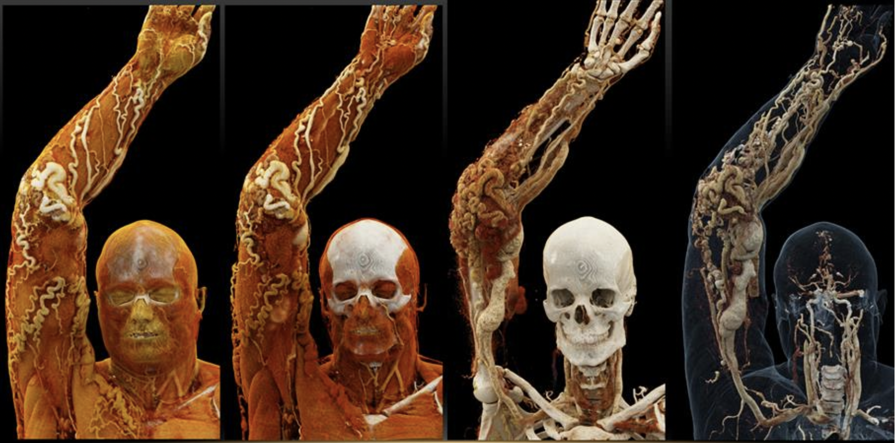
Applications: Medical Science
https://www.heavy.ai/technical-glossary/volume-rendering

Slide 8
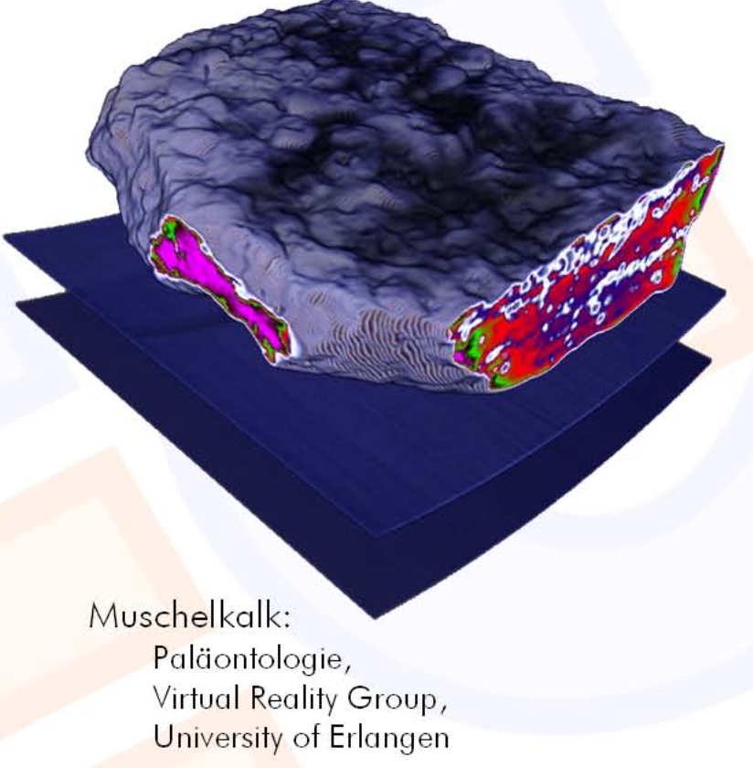
Applications: Geology
Deformed plastic model

Slide 9
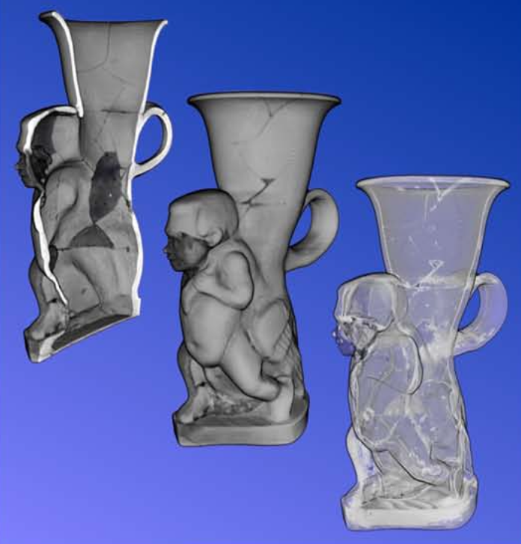
Applications: Archeology
Historical Statute

Slide 10
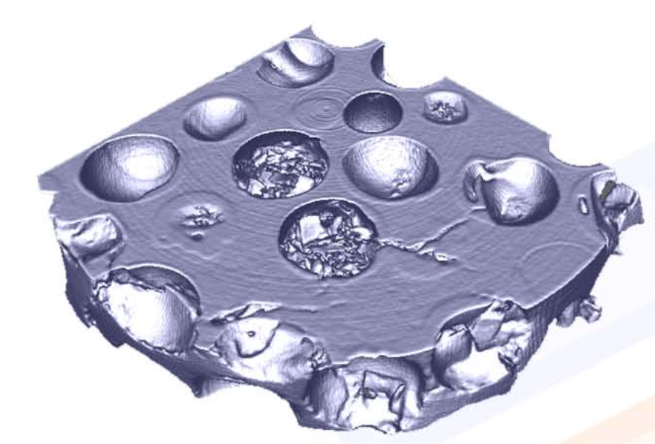
Applications: Materials Science
Quality control

Slide 11
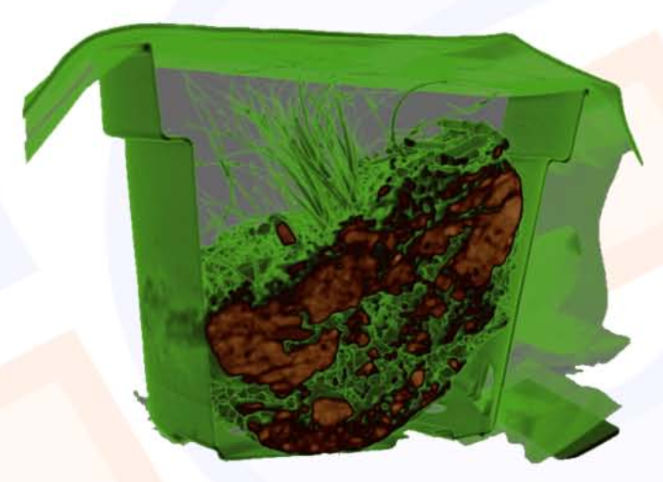
Applications: Biology
Biological soil
samples

Slide 12
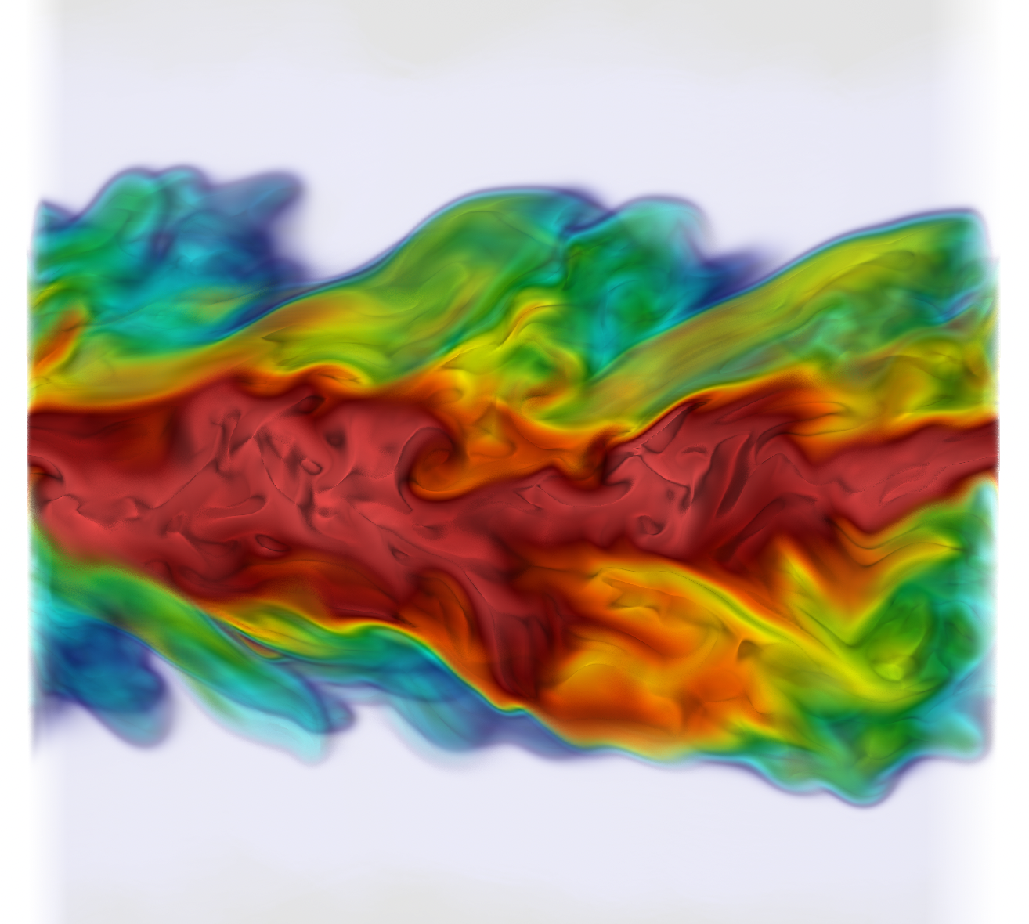
Applications: Computational Sciences
Study Combustion
process

Slide 13
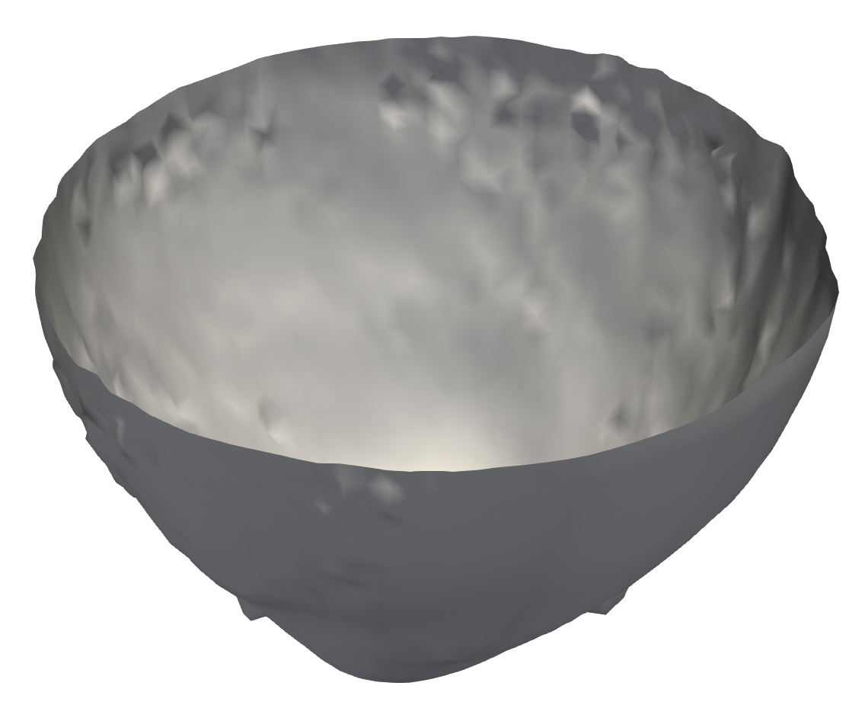
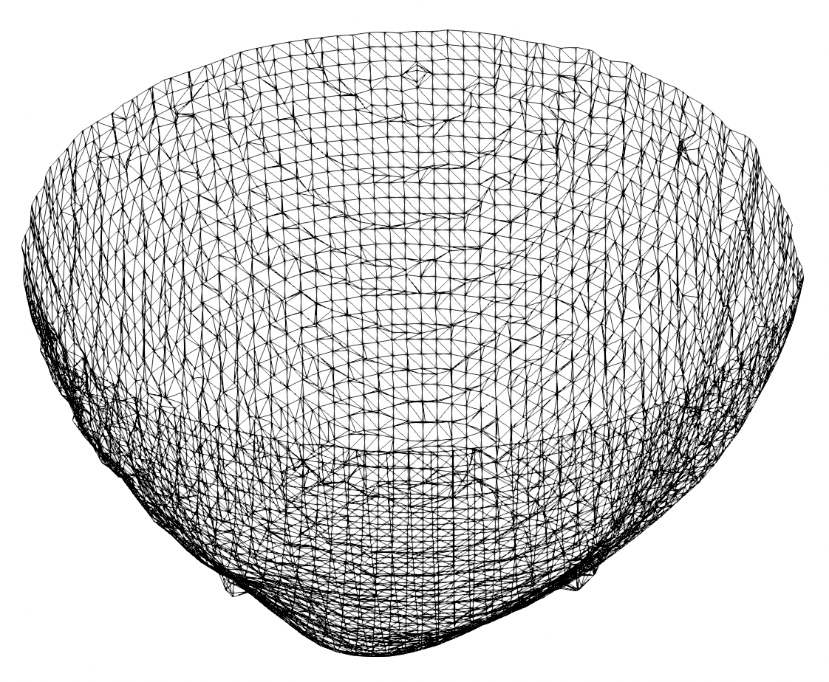
Indirect Visualization of Volume Data
Isosurface based rendering for 3D data
Example of indirect technique for volume data exploration
Using geometric representations
Points, meshes, surfaces, etc.
Isosurface
Geometric mesh of the isosurface

Slide 14
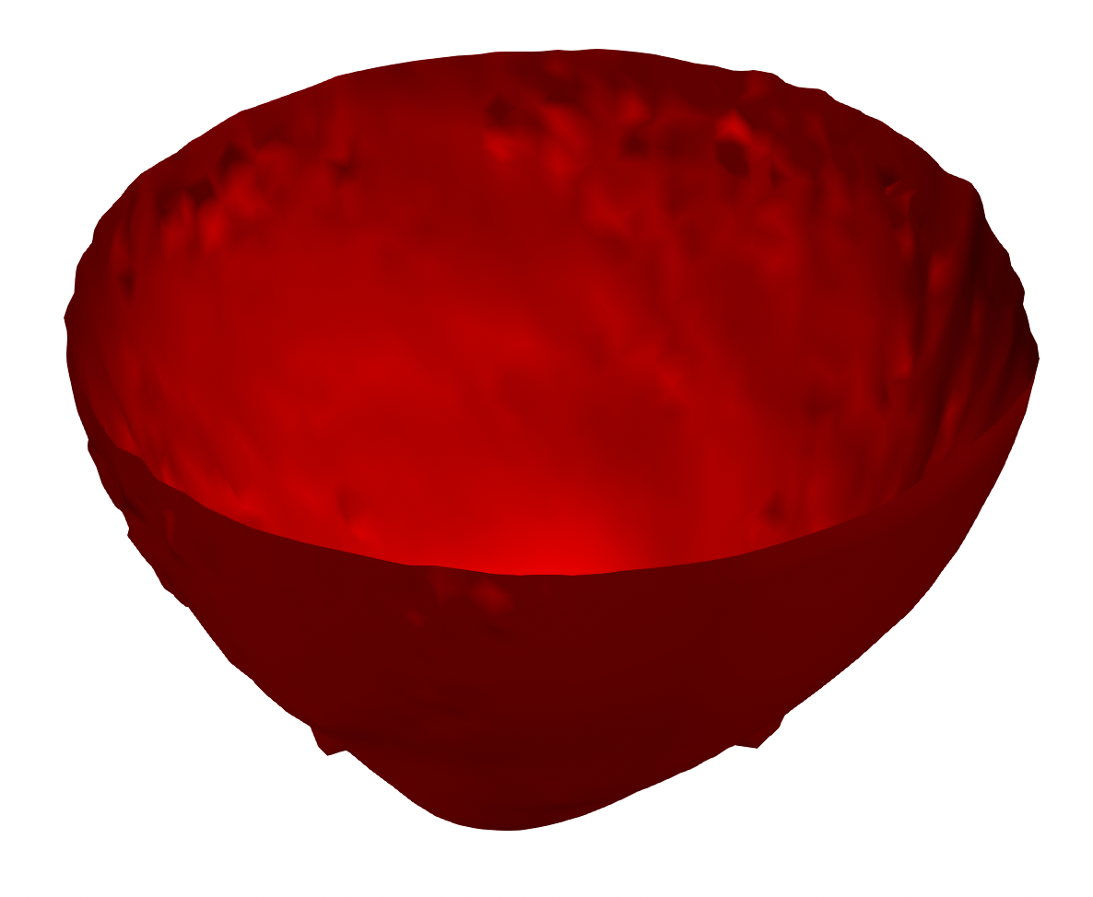
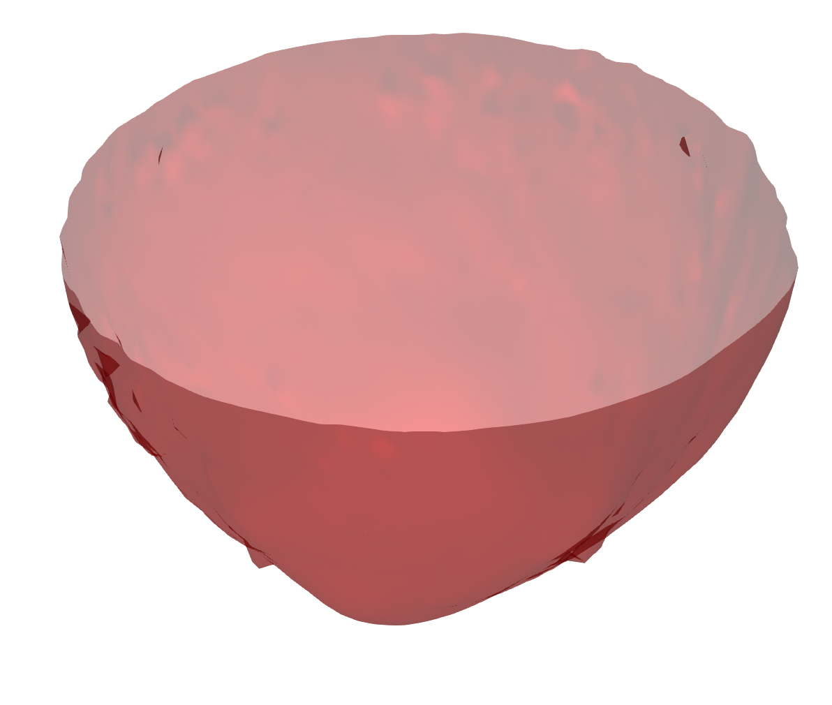
Volume Rendering
Surface visualization is a way of showing data as opaque objects
Though you can apply transparency on surfaces
Many applications demand techniques that allows “see-through” capability
Make parts of the data (semi)transparent so the data behind can be seen
Volume Rendering technique is the answer!
Direct mapping of underlying 3D data into an image space
Assumes data as a translucent gel that allows light to go through
Opaque
Semi-transparent

Slide 15
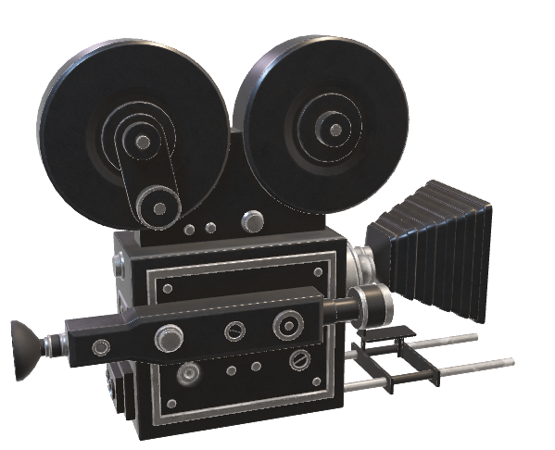
Volume Rendering Key Idea
Data is considered as a translucent gel
Rays are cast into the volume data through each pixel to observe data values
Rays accumulate color and opacity values along the ray for final pixel color
Data samples along the ray
Image plane
3D Data

Slide 16
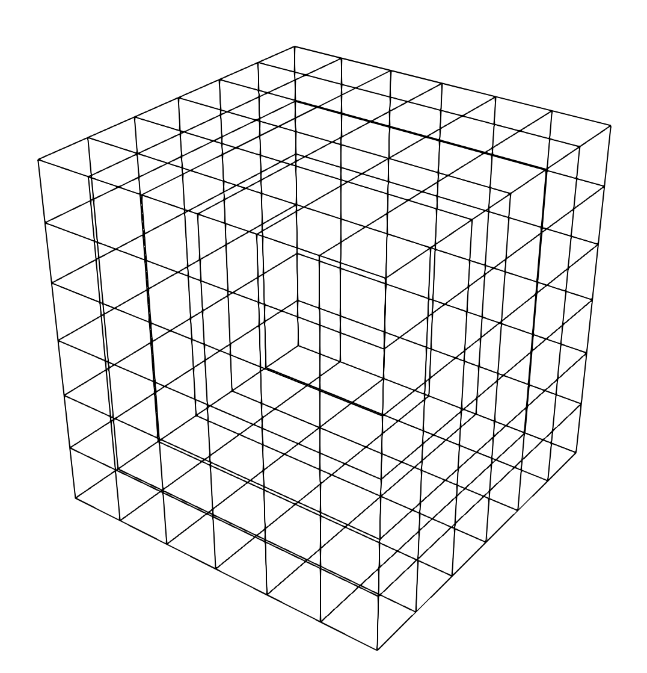
Sampling via Trilinear Interpolation
A single cube cell of the data
Grid of the data set

Slide 17
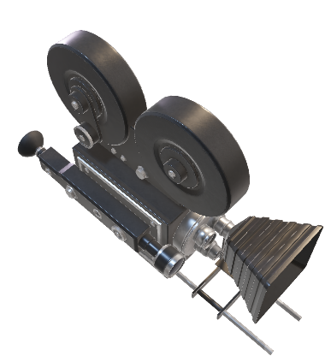
Sampling via Trilinear Interpolation
Sample point where data value needs to be computed
View ray
A single cube cell of the data

Slide 18
Different Volume Rendering Algorithms
Image-order techniques
Ray casting approaches
Object-order techniques
Splatting
Texture mapping

Slide 19
Different Volume Rendering Algorithms
Image-order techniques
Ray casting approaches
Object-order techniques
Splatting
Texture mapping

Slide 20
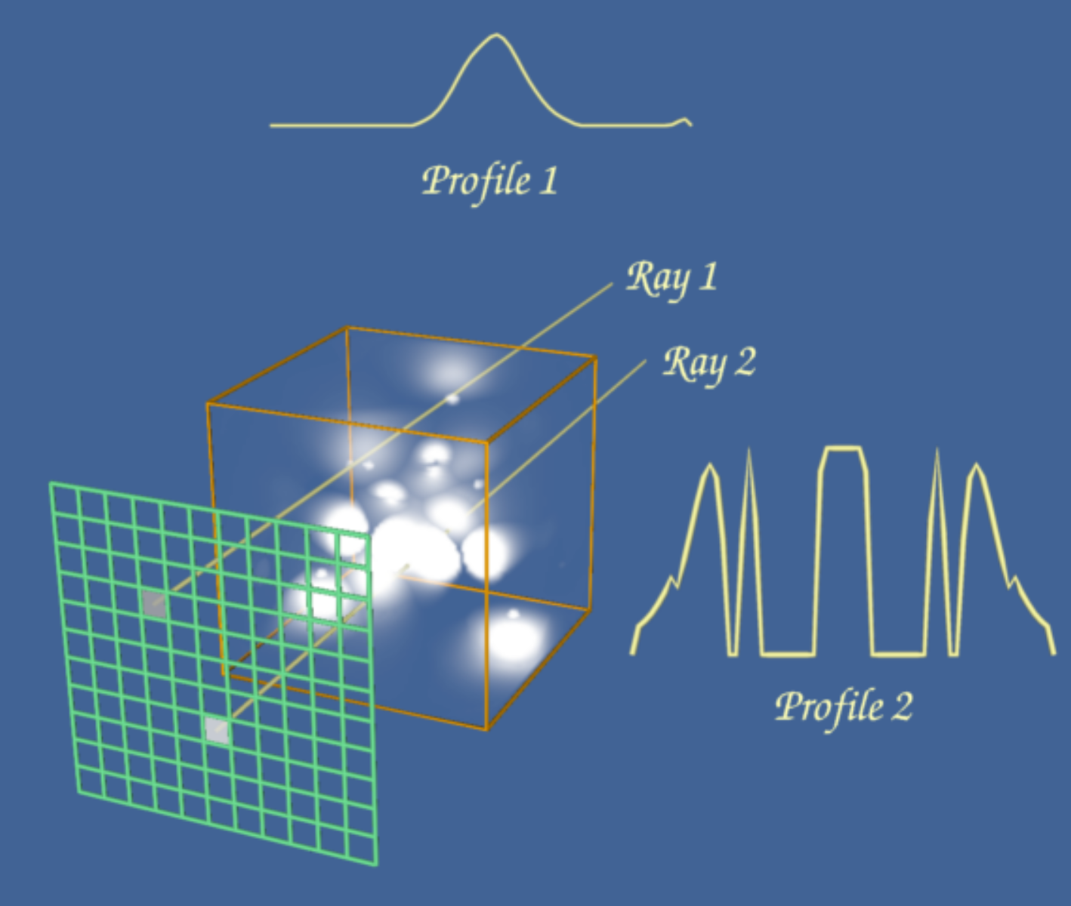
Image-Order Volume Rendering Techniques
Typically known as Ray casting methods
Given an image plane, for each pixel, we compute the color by casting a ray through each pixel to the data
We evaluate the data along the ray using some pre-specified functions for computing the final pixel color

Slide 21
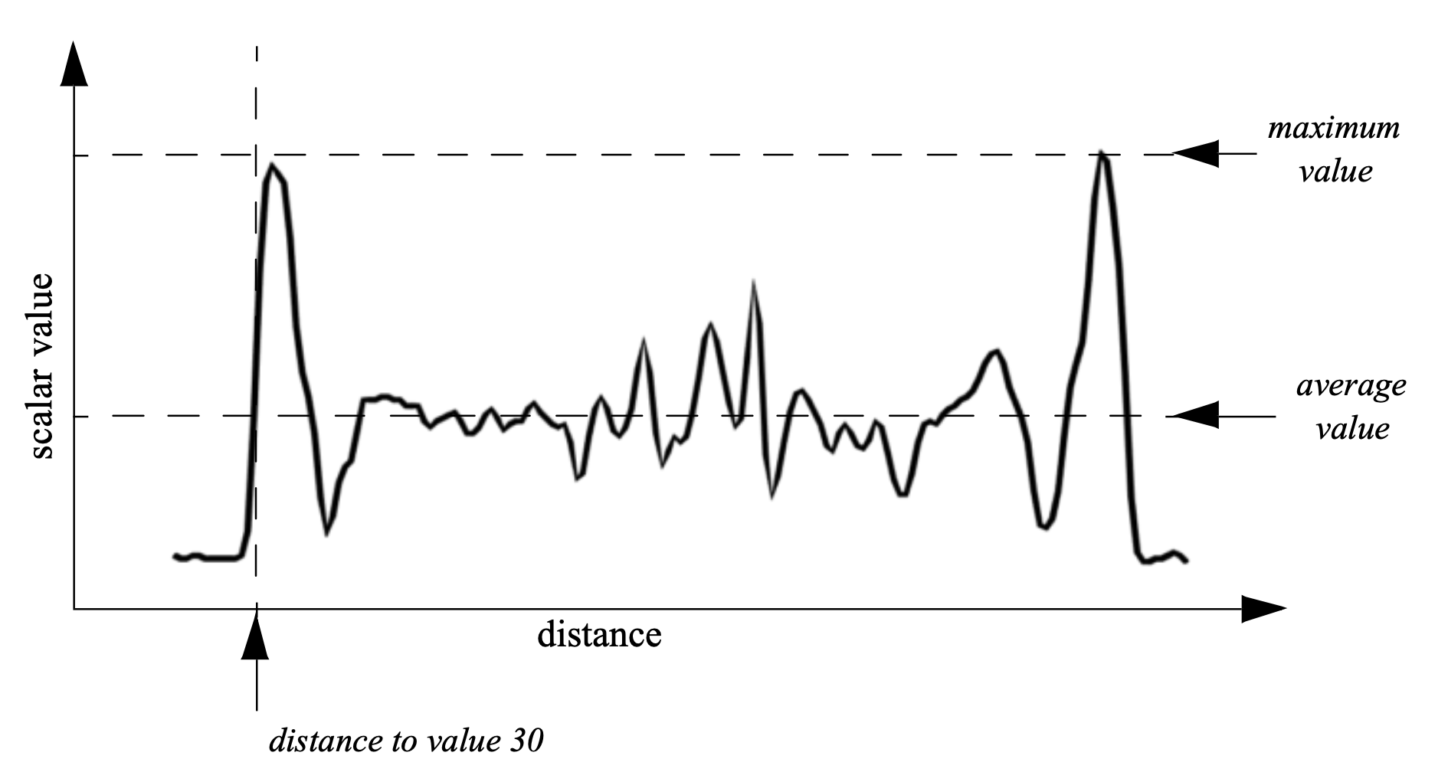
Image-Order Volume Rendering Techniques
How do we accumulate the data values along the ray to produce a final pixel color?
Maximum Intensity Projection (MIP)
Average Intensity Projection (AIP)
Distance to a value
Compositing

Slide 22
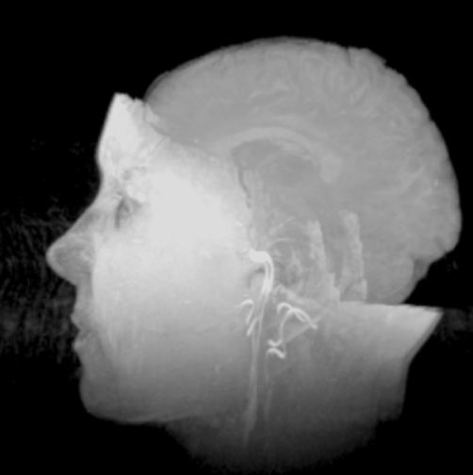
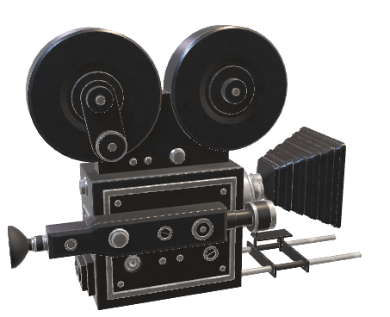
1. Maximum Intensity Projection (MIP)
Compute the maximum intensity (data) value along each casted ray and the map the value to a color using a color scale
Take the maximum value
Image plane

Slide 23
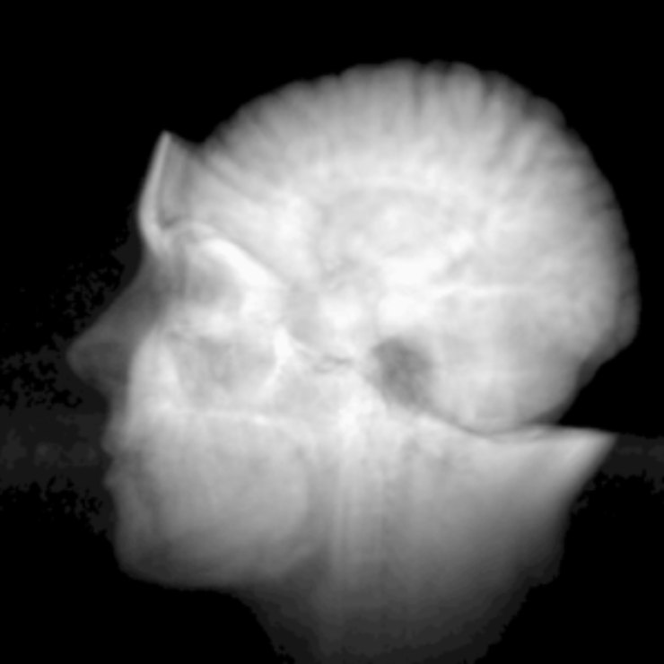
2. Average Intensity Projection (AIP)
Compute the average intensity (data) value along each casted ray and the map the value to a color using a color scale
Take the average value
Image plane

Slide 24
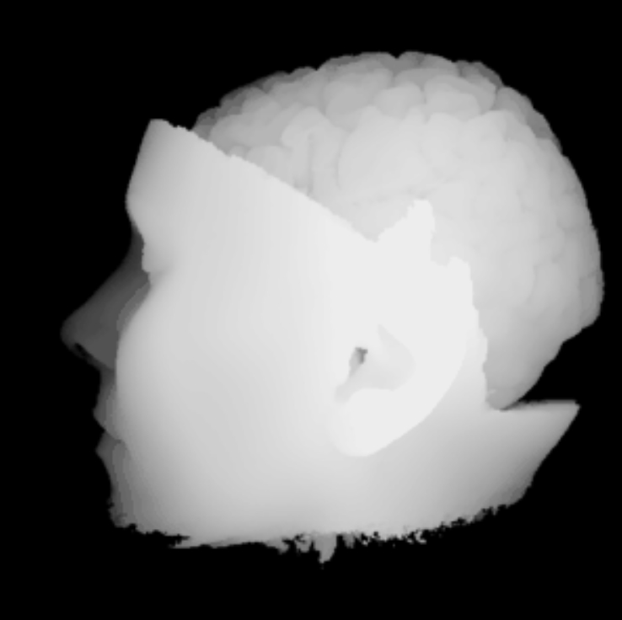
3. Distance to a Value Projection
Distance to value 30 is shown in the rendered image
Provides the notion of the depth as to where the data value 30 is encountered
Take the distance to a specific value when encountered first
Image plane

Slide 25
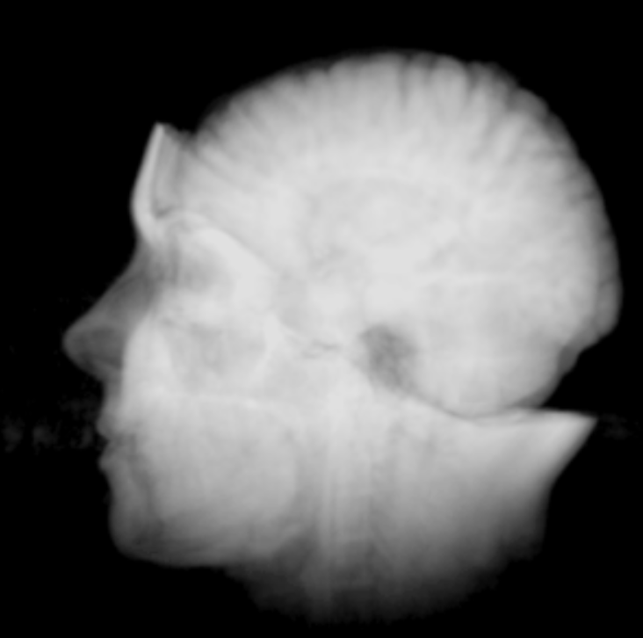

4. Composite Values Along the Ray
Use an alpha (opacity) composting technique to blend the color values obtained from data samples along the ray
Blend/composite colors from the samples
Image plane

Slide 26
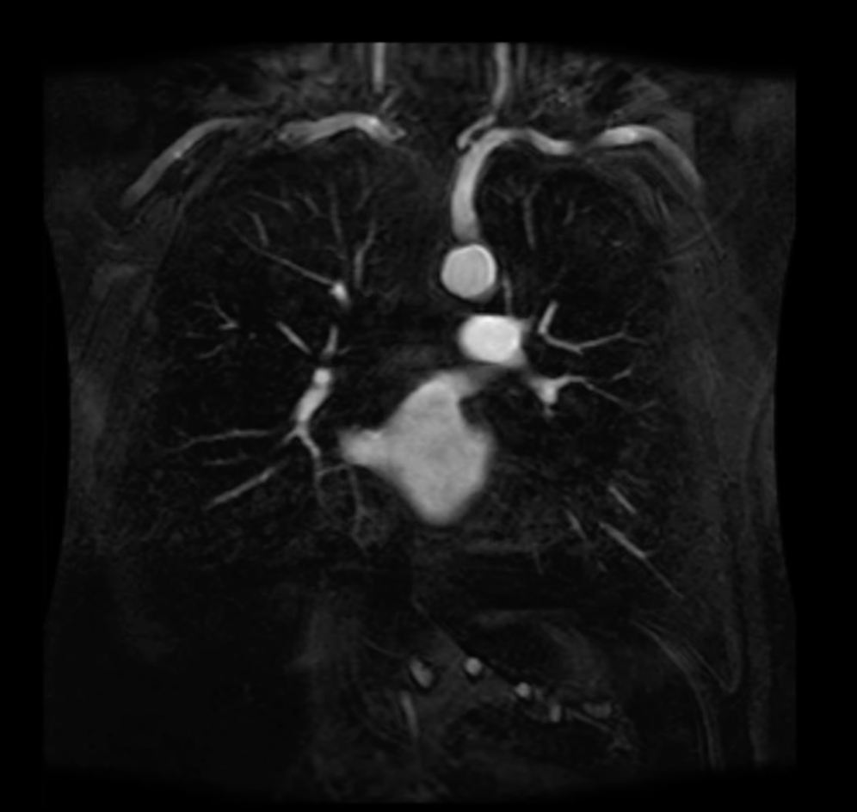
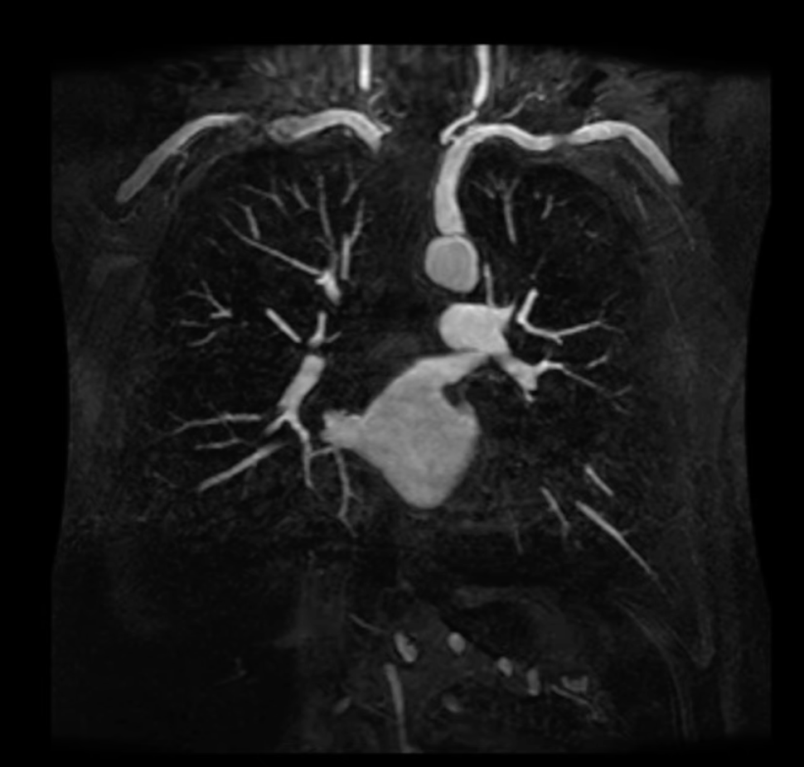
AIP vs MIP
AIP: Lower noise and smoother edges
MIP: Good for bright structures
https://www.youtube.com/watch?v=Uu_h49xEls8

Slide 27
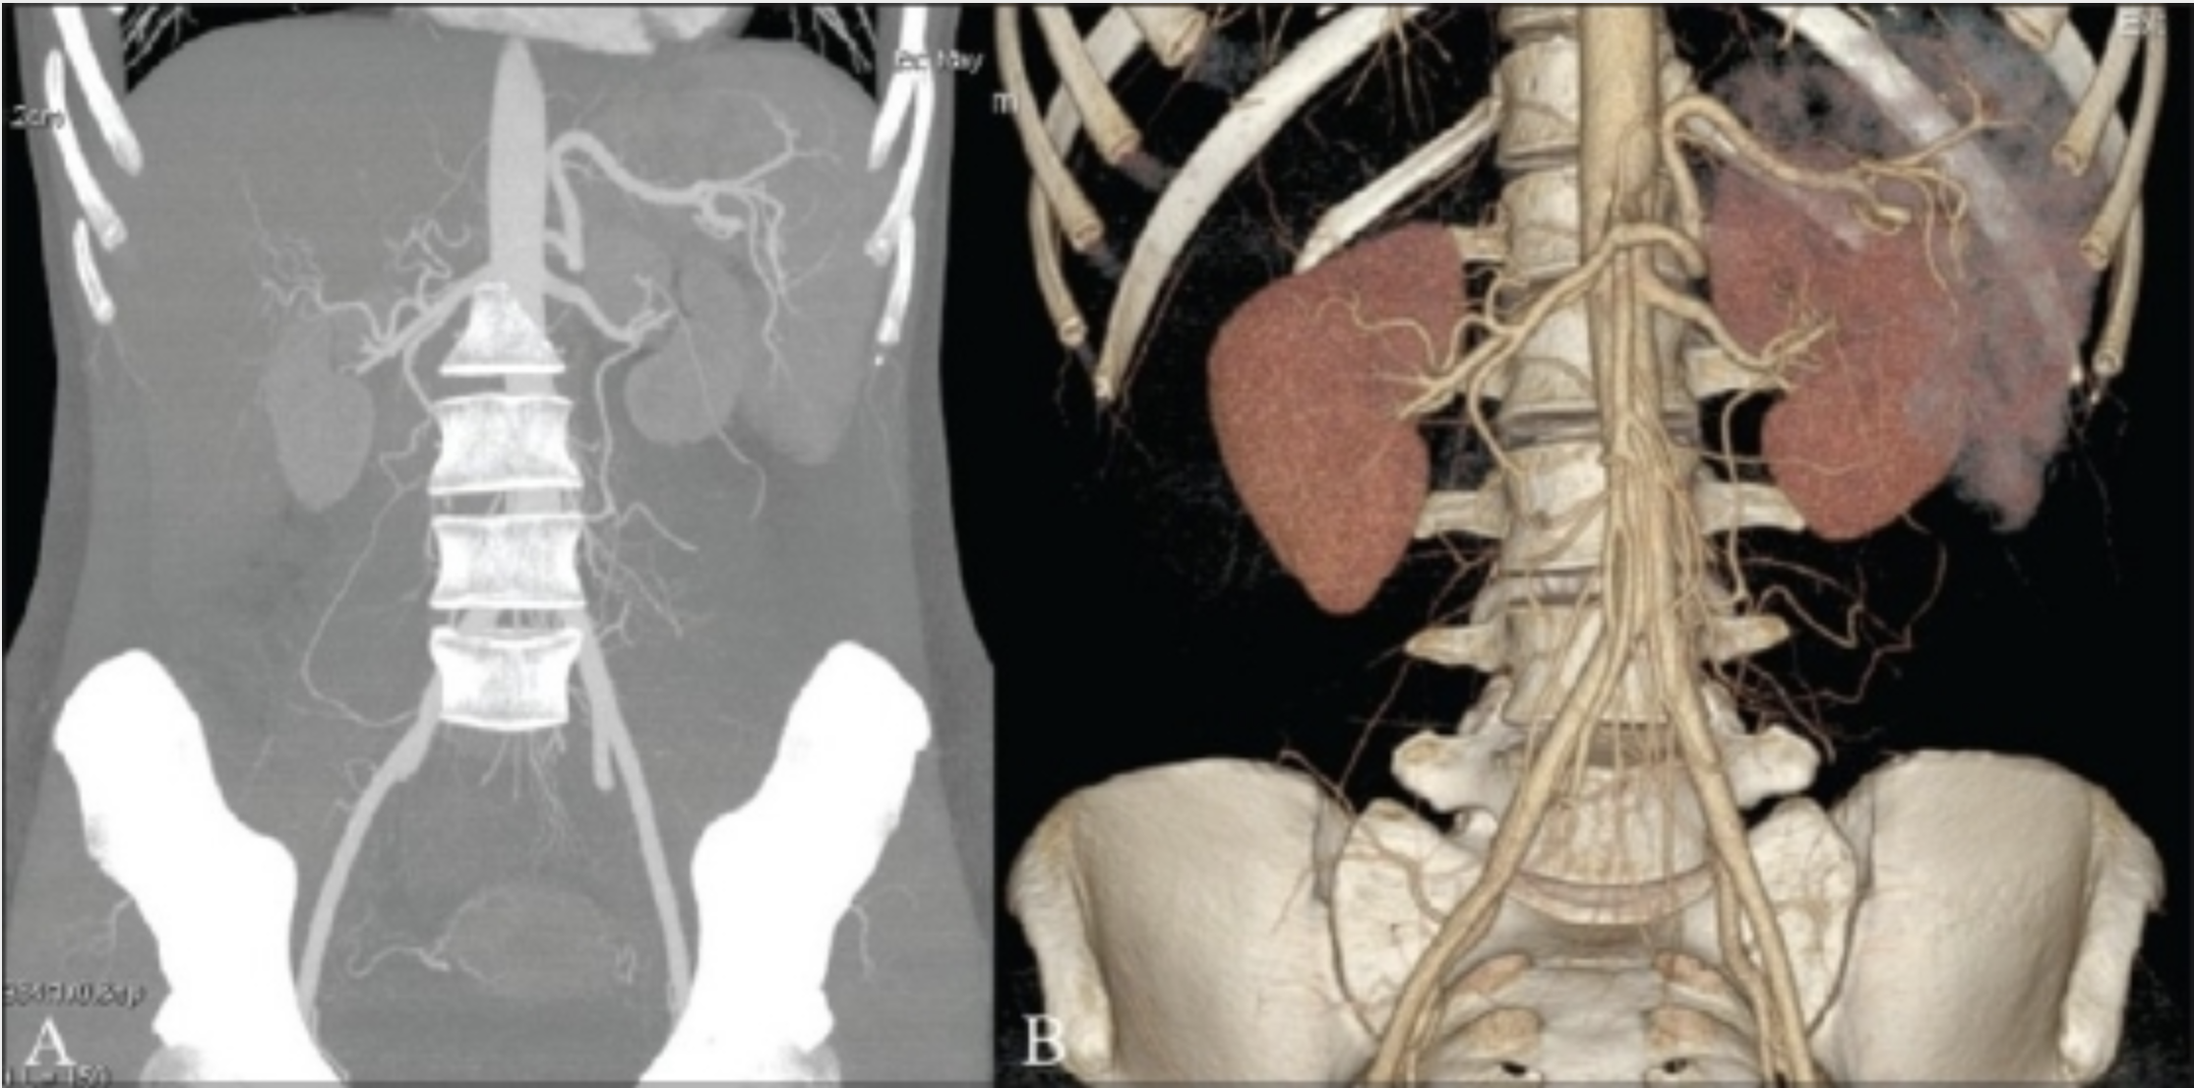
MIP vs Compositing-based Volume Rendering
Maximum Intensity Projection
Compositing
https://europepmc.org/article/med/20607017

Slide 28
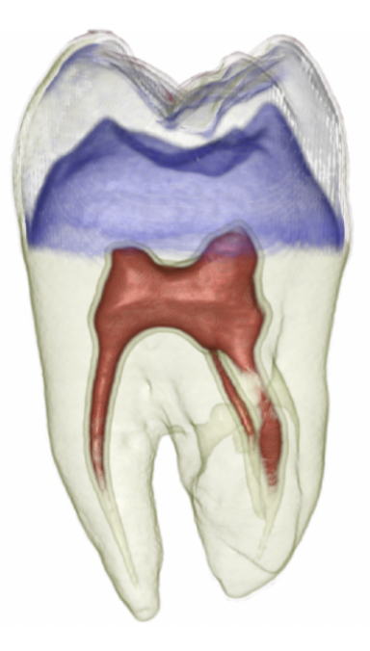
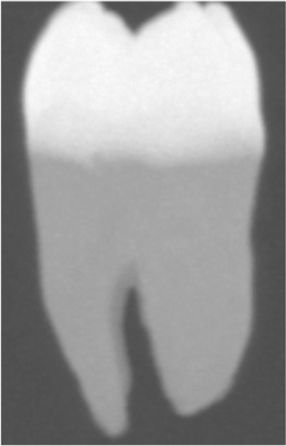
MIP vs Compositing-based Volume Rendering
Maximum Intensity Projection
Compositing
Software Infrastructure for exploratory visualization and data analysis: Past, present, and future, Silva and Freire, 2008

Slide 29
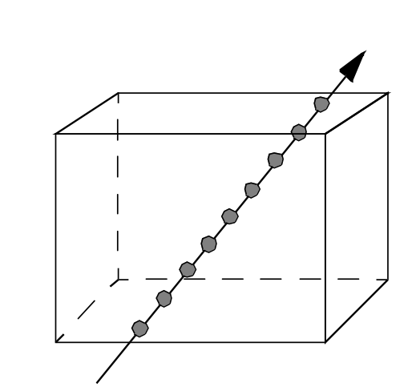
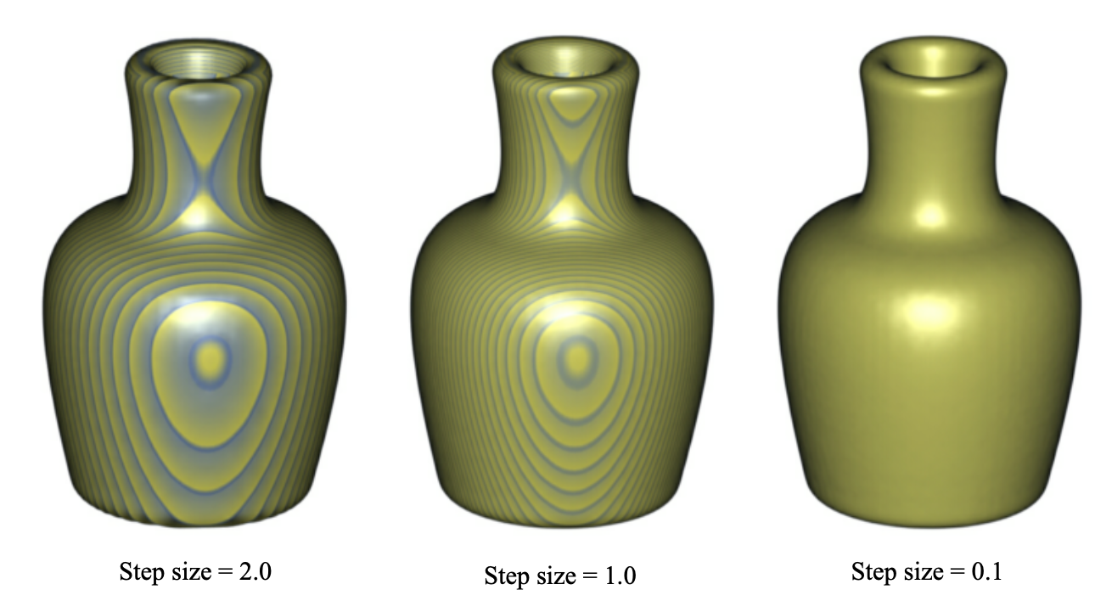
Effect of Step Size During Ray Traversal
The quality of the image produced from the data depends on the step size when each ray is traversed through the data
Large hop/step size causes artifacts in the final image
Smaller step size makes image more accurate but also computationally more expensive
Step size

Slide 30
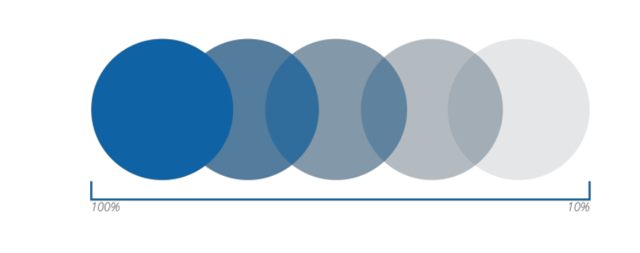
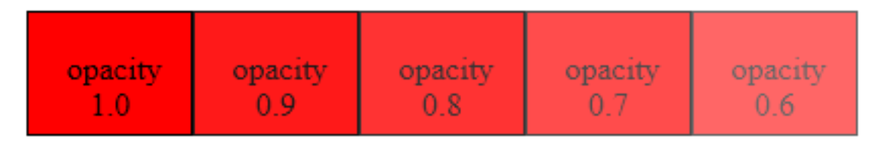
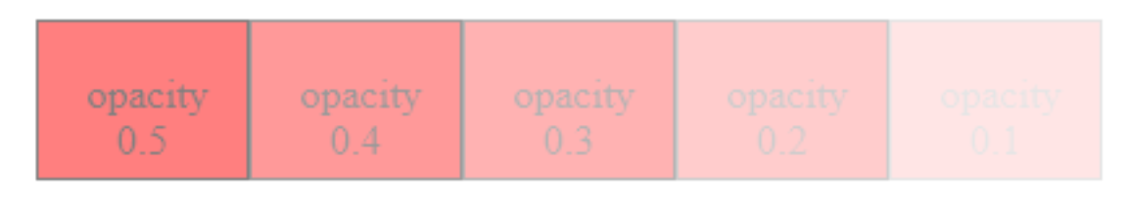
Transparency and Opacity
Other than RGB color values, there is one more channel – opacity (A)
Compute RGBA color components
Opacity (A) = 1 – transparency (T)
Range [0.0 ... 1.0]
Opacity (A) multiplied by RGB color creates a weighting effect

Slide 31
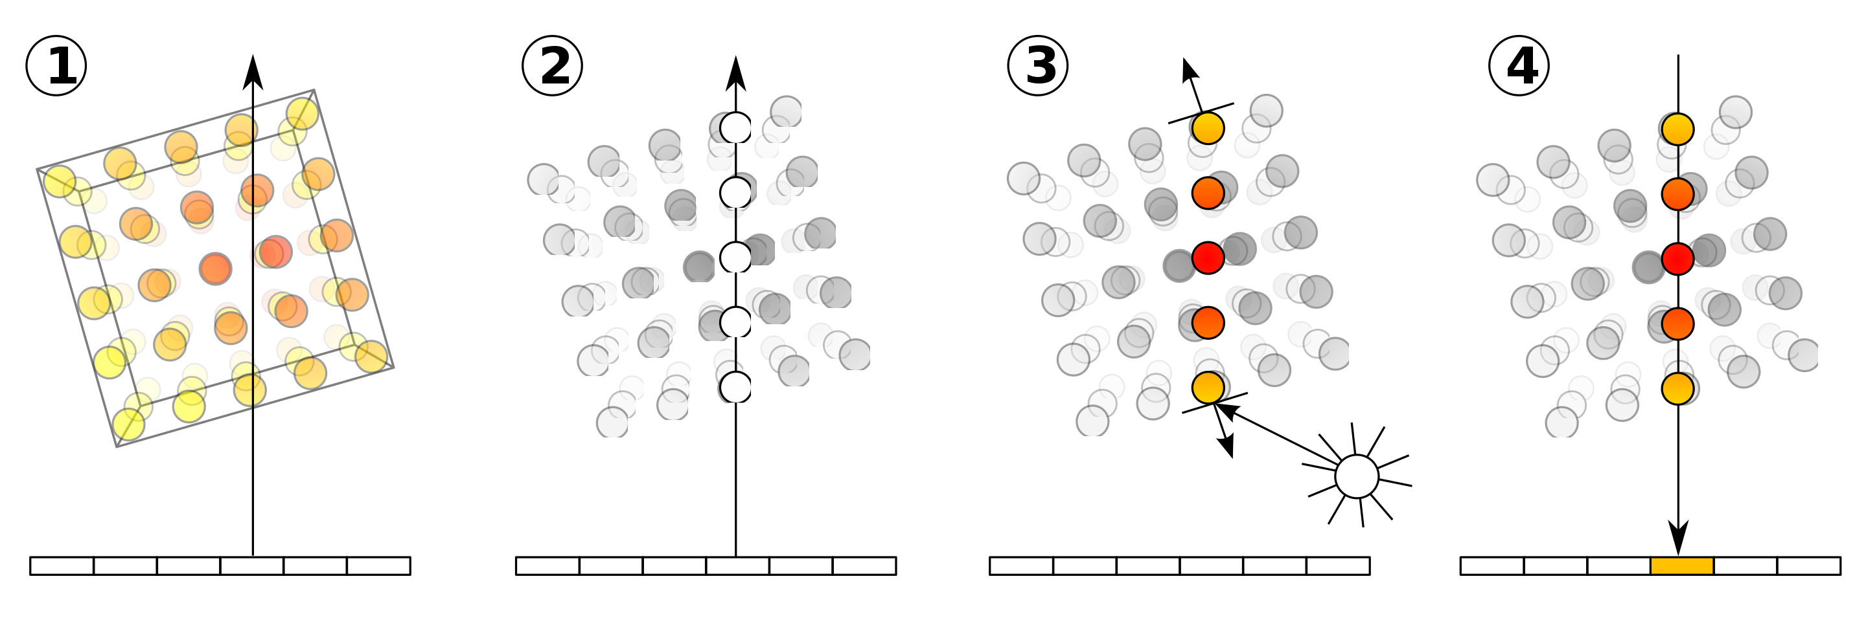
Ray Casting and Compositing
Direct Volume Rendering
1. Ray Casting 2. Sampling 3. Shading 4. Compositing
Wikipedia

Slide 32
Ray Casting and Compositing
Direct Volume Rendering
1. Ray Casting 2. Sampling 3. Shading 4. Compositing
Wikipedia

Slide 33
Ray Casting and Compositing
Direct Volume Rendering
1. Ray Casting 2. Sampling 3. Shading 4. Compositing
Wikipedia

Slide 34
Ray Casting and Compositing
Direct Volume Rendering
1. Ray Casting 2. Sampling 3. Shading 4. Compositing
Wikipedia

Slide 35
Ray Casting and Compositing
Direct Volume Rendering
1. Ray Casting 2. Sampling 3. Shading 4. Compositing
Wikipedia

Slide 36
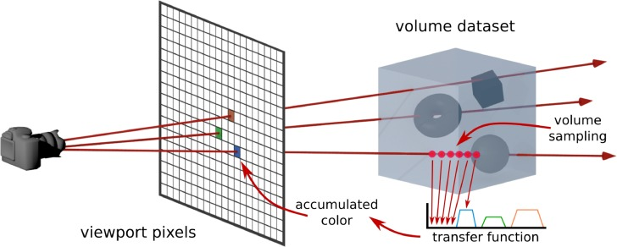
Ray Casting and Compositing
Direct Volume Rendering
https://www.sciencedirect.com/science/article/pii/S009784931830030X

Slide 37
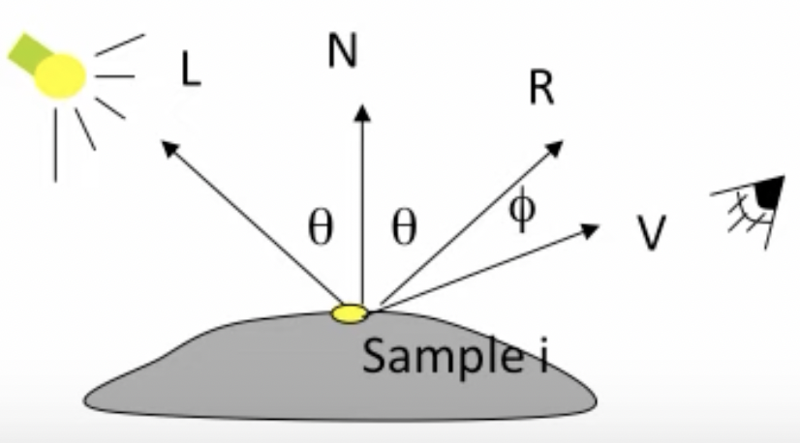
Shading: Phong Illumination Model
Shading is the process of computing final color for each pixel considering its color, opacity, location of the viewer, distance and direction of the light, etc.
Phong Illumination = ambient + diffuse + specular

Slide 38
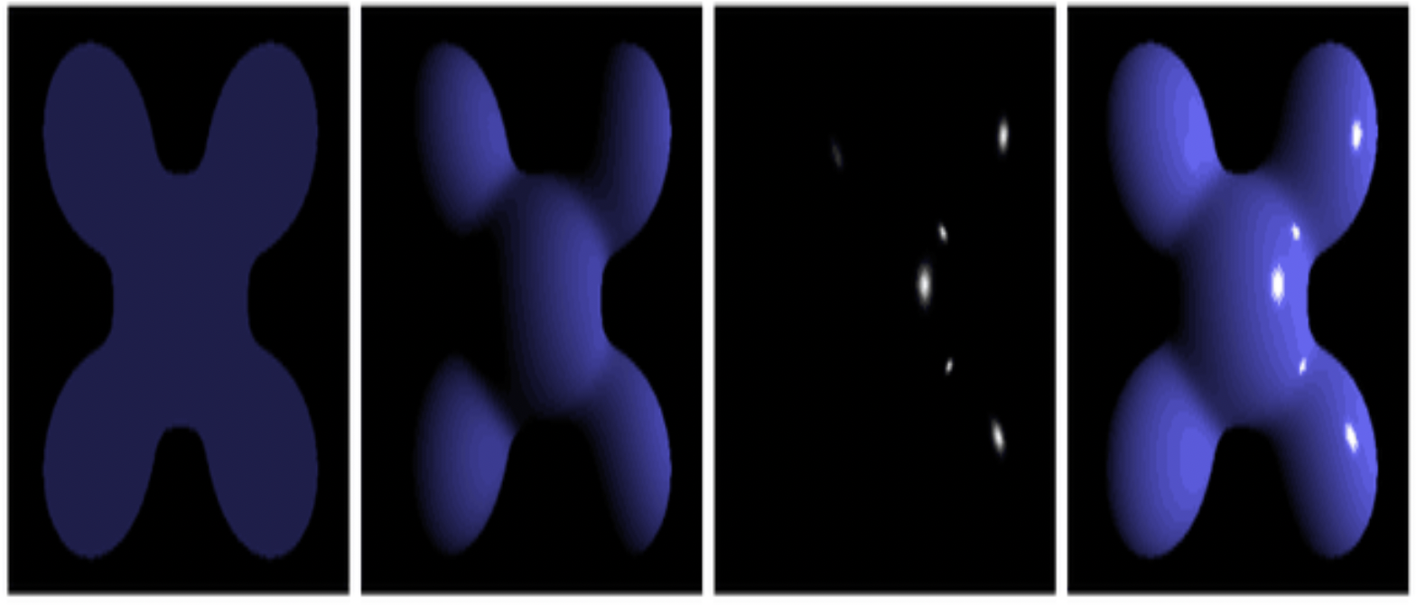
Shading: Phong Illumination Model
Illumination = ambient + diffuse + specular
Ambient
Diffuse
Specular
Ambient +
Diffuse + Specular
https://svenbob.github.io/report%20of%20Project3

Slide 39
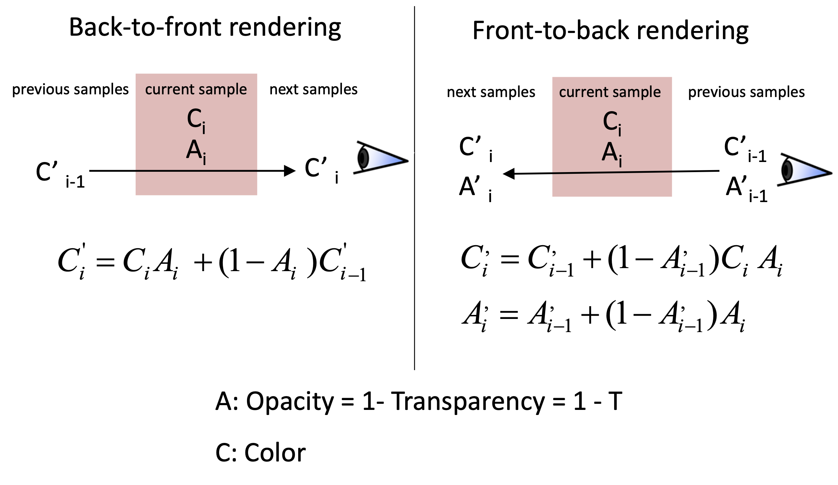
Opacity and Color Blending: Compositing

Slide 40
Opacity and Color Blending: Compositing

